Slide 1
Business Process for Resolving Internet Faults
Derly Julieth Varón Ducuara - 160004444
Leiner Libardo Mendoza Rodriguez - 160004249

Slide 2
BUSINESS PROCESS
Initial Assessment
CSR receives report, gathers customer information, and performs initial troubleshooting steps.
01
Remote Diagnostics
If issue persists, technical support agent remotely diagnoses problem, identifies potential causes.
02
On-Site Visit (if required)
03
If the fault cannot be resolved remotely, the technical support agent schedules an on-site visit to the customer's location.
Escalation (if necessary)
04
If issue persists, advanced technicians and engineers analyze for broader network issues.

Slide 3
BUSINESS PROCESS
Communication and Updates
Customer kept informed about progress, expected resolution times.
05
Final Confirmation
06
CSR confirms resolution with customer, collects feedback.
Documentation and Analysis
07
Actions, resolutions, and analysis documented, trends and improvements identified.
Continuous Improvement
08
Data used for process enhancement, adjustments made to prevent similar issues.

Slide 4
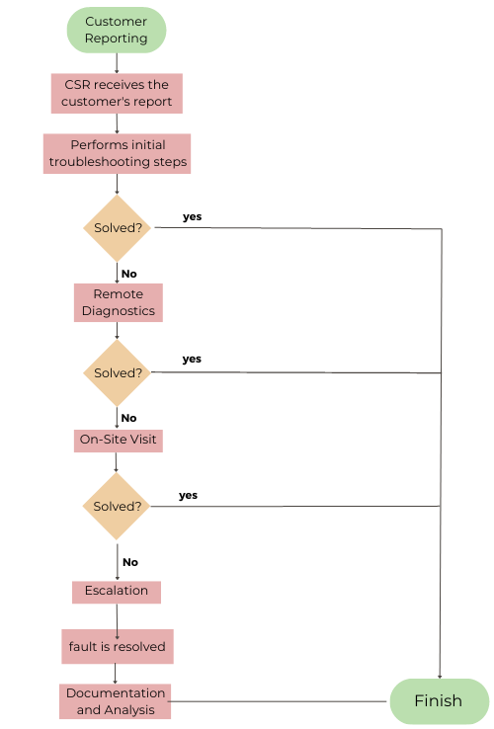

Slide 5
RESULTS
The fault is resolved without technical intervention
The fault is solved with remote diagnosis
The fault is resolved with the technical visit
EXCELLENT
In terms of time and customer satisfaction
The fault is solved with basic technical procedure
Fault is resolved after escalation
GOOD
The fault is not resolved
BAD
LOW VALUE
MEDIUM VALUE
HIGH VALUE
In terms of the value it generates for the company

Slide 6
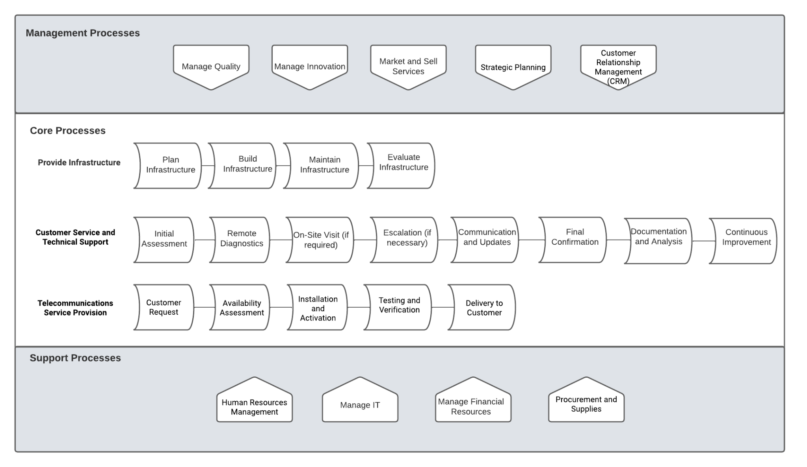

Slide 7
Empresa de telecomunicaciones MVS
Actores: rsc, tecnico,
Un usuario realiza una solicitud de daño en el servicio de internet, la empresa recibe la solicitud de reparación y se pone en espera a ser atendida por un representante de servicio al cliente

